Slide 1
Olympia oyster
QuantSeq project
Data from …
3 populations
2 generations (3 life stages)
2 parental pCO₂ treatments

Slide 2
Analysis option 1:
Effect of high pCO₂ exposure on Olympia oyster physiology across generations, life stages, & populations
Adult HIGH
pCO2 exposure
Adult AMBIENT pCO2 exposure
VS.
2 generations, 3 life stages
3 populations
pCO2 exposure
Fidalgo Bay
Dabob Bay
Oyster Bay
Adults
Larvae
1-yr old offspring

Slide 3
Adult expression upon direct exposure to high pCO₂ (ctenidia tissue) - DEGs
Fidalgo Bay – 76 DEGs
Dabob Bay – 132 DEGs
One DEG in Oyster Bay, but not at all convincing

Slide 4
Varying amounts of growth during high pCO2 exposure

Slide 5
Enriched Biological Processes,
DEGs in Fidalgo Bay ADULTS exposed to high pCO2

Slide 6
Enriched Biological Processes,
DEGs in Dabob Bay adults exposed to high pCO2

Slide 7
Four genes were DEGs in both Fidalgo Bay & Dabob Bay upon high pCO₂ exposure
CYP2B4: Cytochrome P450 2B4
FABP4: Fatty acid-binding protein
Lipid transport
CYP2U1: Cytochrome P450 2U1
DIO3: Thyroxine 5-deiodinase
Hormone biosynthesis
& metabolic processes
pCO₂
CYP = response to oxidative stress, xenobiotics, hormone stuff. Common stress-response enzyme.
Notes:
CYP2B4: Cytochrome P450 2B4
FABP4: Fatty acid-binding protein
- Lipid transport protein in adipocytes.
DIO3: Thyroxine 5-deiodinase
- hormone biosynthetic process
- thyroid hormone metabolic process

Slide 8
Diff. expression upon exposure to high pCO2 - LARVAE - Global effects
All populations combined
Dabob Bay
Fidalgo Bay
Oyster Bay C1
Oyster Bay C2
inbred, offspring of C1
pCO2 exposure

Slide 9
Larval expression (pooled) upon parental exposure (only) to high pCO₂
DEGs
Global gene expression, all populations –
no pattern
One! (in Fidalgo Bay)
(Unknown function)
pCO2 exposure

Slide 10
Diff. expression upon parental exposure to high pCO2 - 1-yr olds - Global effects
All populations combined
Dabob Bay
Fidalgo Bay
Parental pCO2 exposure

Slide 11
Could survival differences during field deployment relate to parental pCO₂ exposure influencing gene expression?
Global Gene Expression
Dabob Bay
Survival ~1 yr old offspring in field differed by parental pCO2
Fidalgo Bay
Fidalgo Bay Dabob Bay Oyster Bay F1 Oyster Bay F2
= ambient parental pCO2
= high parental pCO2

Slide 12
HOWEVER … there’s a catch.
Each population / treatment group is genetically distinct.
PCA biplots from SNPs
each color = population + parental pCO2 group

Slide 13
And there are many siblings.
Dabob Bay
Fidalgo Bay
Half sibs (same father)
half sib (same father)
full sibs
Half sibs
(same mother)
half sibs (same mother)
X
Full sibs
Only include Fidalgo Bay non-sibs in 1-yr old DEG analysis

Slide 14
5 DEGs that common among all 4 NON-SIBS sample combinations
Not all that impressive to me
Helicase with zinc finger domain 2
One annotated – BP include
nuclear-transcribed mRNA catabolic process
positive regulation of transcription
regulation of lipid metabolic process

Slide 15
Analysis option 2: Gentotype-dependent expression differences among populations, life stages of Olympia osyter
Fidalgo Bay
Fast growing & larger
Dabob Bay
Smaller
Resilient larvae
Black in color
Oyster Bay C1
High reproductive output
3 populations (four cohorts)
2-3 life stages (adult, larvae, 1-yr old)
Oyster Bay C2
(inbred, from C1)

Slide 16
Diff. expression by population - Adults
Global
DEGs
No. of DEGs among cohorts, Adults (ambient pCO₂ only)
Dabob Bay
379
1.2%
280
0.9%
84
0.3%
Fidalgo Bay
Oyster Bay C1

Slide 17
Diff. expression by population - Adults
All DEGs from pairwise comparisons

Slide 18
Diff. expression by population - Larvae
Global
DEGs
No. of DEGs among cohorts, Larval offspring
260
0.9%
Dabob Bay
252
0.9%
155
0.5%
751
2.5%
Fidalgo Bay
Oyster Bay C1
186
0.6%
0
Oyster Bay C2

Slide 19
Diff. expression by population - Larvae
All DEGs from pairwise comparisons

Slide 20
Diff. expression by population – 1-yr offspring in field
Global
DEGs
No. of DEGs among populations
Fidalgo Bay
1182
Dabob Bay

Slide 21
Diff. expression by population – 1-yr offspring in field
Note: Fidalgo Bay & Dabob Bay only, 1,182 DEGs

Slide 22
Extra slides

Slide 23
Diff. expression upon exposure to high pCO2 - ADULTS - Global effects
All populations combined
Dabob Bay
Fidalgo Bay
Oyster Bay
pCO2 exposure

Slide 24
NON-SIBS only, Fidalgo Bay, DEG analysis – 4 possible sample combinations
Combination 1 – 8 DEGs
Combination 2 – 8 DEGs
Combination 3 – 15 DEGs
Combination 4 – 30 DEGs

Slide 25
a
a
a
a
ab*
b*
a
ab
b

Slide 26
a
a
a
a
a
b

Slide 27
a
a
a
a
a
b

Slide 28
a*
a
a
a
ab*
a
ab
b
a
bc
bc
c
a
a
a
a

Slide 29
a*
a
a
a
ab*
a
ab
b
a
bc
bc
c

Slide 31
High pCO₂-induced DEGs involved in detoxification, redox
pCO₂ Treatment
Gene
Individual

Slide 32
Gene
Individual

Slide 33
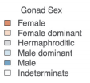
a
a
a
a
ab
b
a
a
b

Slide 35
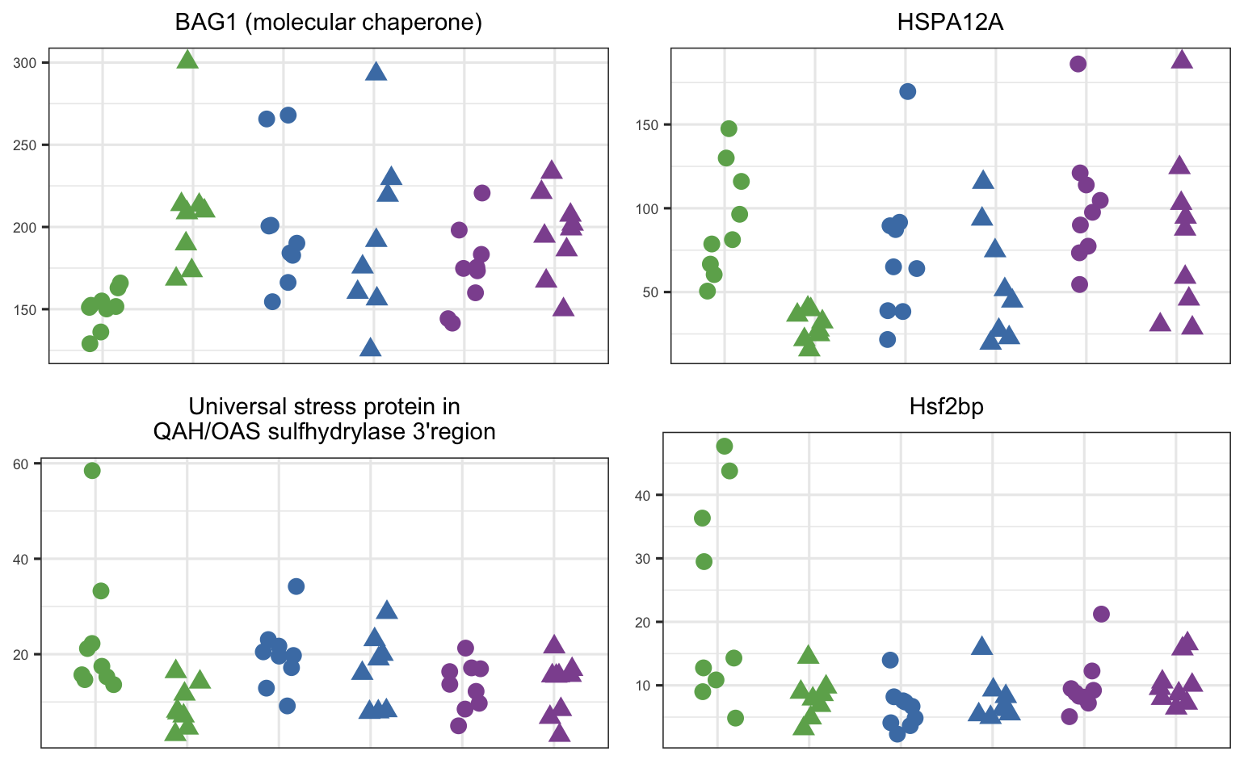

Slide 38
Adult shell growth by pCO₂ exposure and population
a
b*
a
a
a
ab
a
a
a
Pre-pCO₂
Post-pCO₂
Pre-pCO₂
Post-pCO₂
Pre-pCO₂
Post-pCO₂

Slide 39
Prevalence of females by population and pCO₂ treatment
b
Proportion female-dominant
b
a
a
a
a
ab
a
a
Pre-pCO₂
Post-pCO₂
Pre-pCO₂
Post-pCO₂
Pre-pCO₂
Post-pCO₂

Slide 40
Enriched Biological Processes

Slide 41
Enriched Biological Processes

Slide 42
Enriched Molecular Functions
All Populations

Slide 43
More abundant
Less abundant

Slide 44
Fidalgo Bay
Dabob Bay
Oyster Bay
Notes:
When I entered the Roberts Lab I was uniquely positioned to investigate effects of acidification across muyltiple populations due to the work of former lab member sand collaborators-
who - through a combination of hatchery experiments, field tests, and genetic analyses -
have identified and characterized three distinct populations of Olympia oysters in the Puget Sound.
I'm going to briefly summarize thoes populations, and highlight their unique characteristics.
The population found in the northern reaches of Puget Sound is unique in that they grow really fast, and they get bigger than the other opulations.
On the contrat ... A population from Hood Canal grows slowly, and they don't ultimately get very large.
A population from the Southern part of Puget Sound is extremely fecund- they reaproduce early, and often.
Genetic analysis indicates that there is weak but significant genetic structure among these populations - and this may be related to their local environments.
The Northern puget sound location is relatively cool and influenced the Pacific Ocean.
The Hood Canal location is notorious for having slow circulation, and as ar esult it can become quite stratiifed, resulting in extreme temperature, dissolved oxygen, and pH conditions.
The Southern Puget Sound location is much warmer, the water column is mixed, conditions are less dynamic, and it's a highly productive basin - that's where a ton of shellfish aqualcuture happens.
I explored the response of these three populations to acidificaiton.

